Slide 1
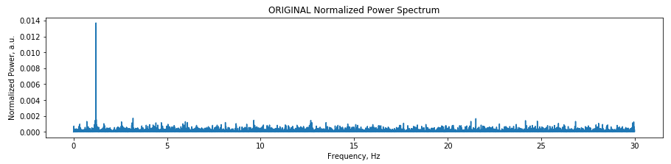
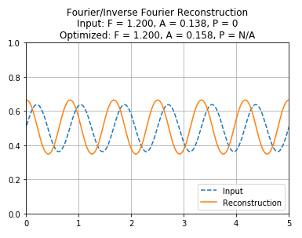
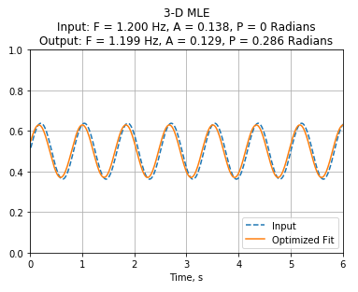
Using data from our simulated friend, the 8000x Gx^49 with 1.2 Hz amplitude noise, MLE actually did better than Fourier Analysis!!!
I used the Fourier results to estimate F and A, and looked for the minima in a narrow band of frequencies, amplitudes, and phases. It was pretty slow, though.

Slide 2
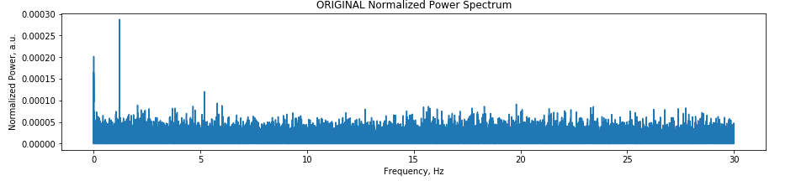
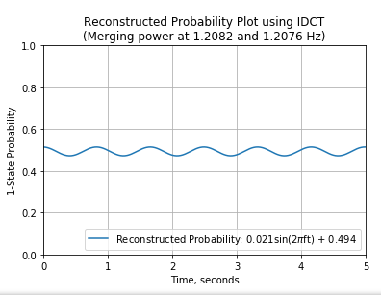
For a set of 186000 GxGi32Gy data points spanning 3100 seconds,
Here’s what I got with Fourier analysis.
Let’s try it again with various amounts of data in the MLE in the next few slides.
(Using all 186K points takes a very, very long time for MLE, probably hours)

Slide 3
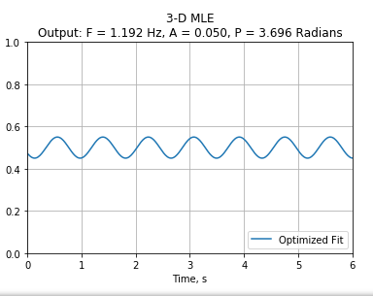
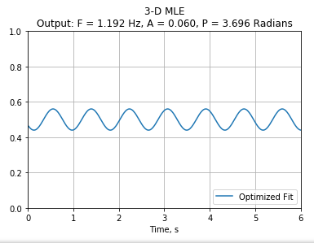
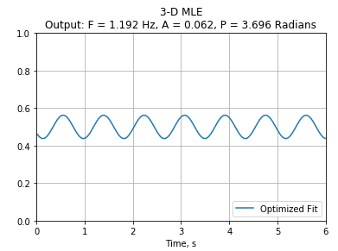



These all only used the first 2000 points (0 to 33 seconds)
There may be a chance it’s actually working here. It’s been picking the maximum amplitude when I scanned from 0.01 to 0.04, then from 0.01 to 0.05. This is better than if it always picked the minimum amplitude from the scan, like it was doing earlier this week. If the best fit amplitude is non-zero, then there may actually be a meaningful minimum nearby.

Slide 4
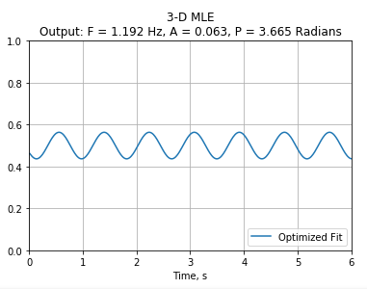
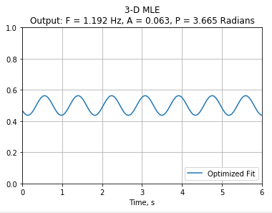
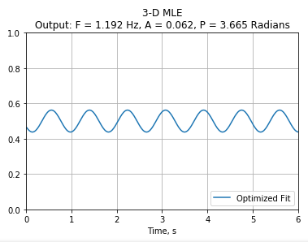



Now I’m going to try and check if this is actually a global minimum by gradually expanding the boundaries and increasing the resolution
It really seems to like these parameters. I’ll shrink the scan range down, but increase the number of included data points

Slide 5
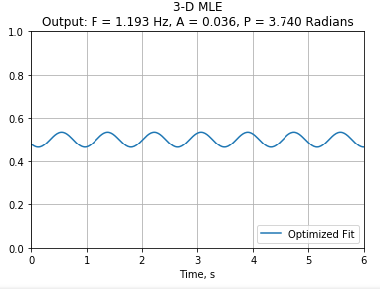
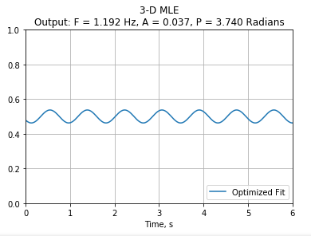


Here I tried increasing the number of data points to 6000. Things changed a little bit.
It seems like the longer you go, the amplitude decreases.
Fortunately, this amplitude is right in the middle of the scan, so that means it’s not just a zero amplitude, which could occur if it always chose the bottom limit of the scan.

Slide 6
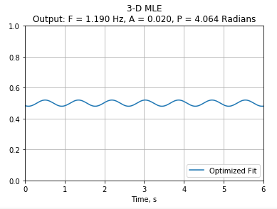

Final thoughts from Friday, 12OCT:
Including the first 12,000 points gave me the following graph, at the minimum of the amplitude parameters. It took about 15 minutes to run, so I’ll need to change parameters appropriately later, with a smaller frequency band and a lower amplitude range.

Slide 7
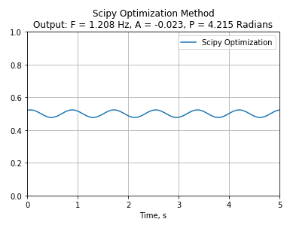
Using the Scipy optimization, I was able to get similar results to my 3D optimization method, but in a much shorter amount of time. Compare these results to the ones from the last slide:
The only difference is that the amplitude is negative for the scipy method compared to my old optimization. The magnitudes of all the parameters are similar though.

